Slide 1
Welcome to Week Two
Before I formed you in the womb I knew you, and before you were born I consecrated you.
Jeremiah 1:5

Slide 2
Called By Name
Confirmation completes Baptism, by which in the laying on of hands and the anointing with Chrism Oil, which first happened at Baptism, we are confirmed with the fullness of the Holy Spirit.
We are reminded of our participation in the ministry and mission of Jesus, and strengthened to follow Jesus more closely.

Slide 3
Servants of God

Slide 4
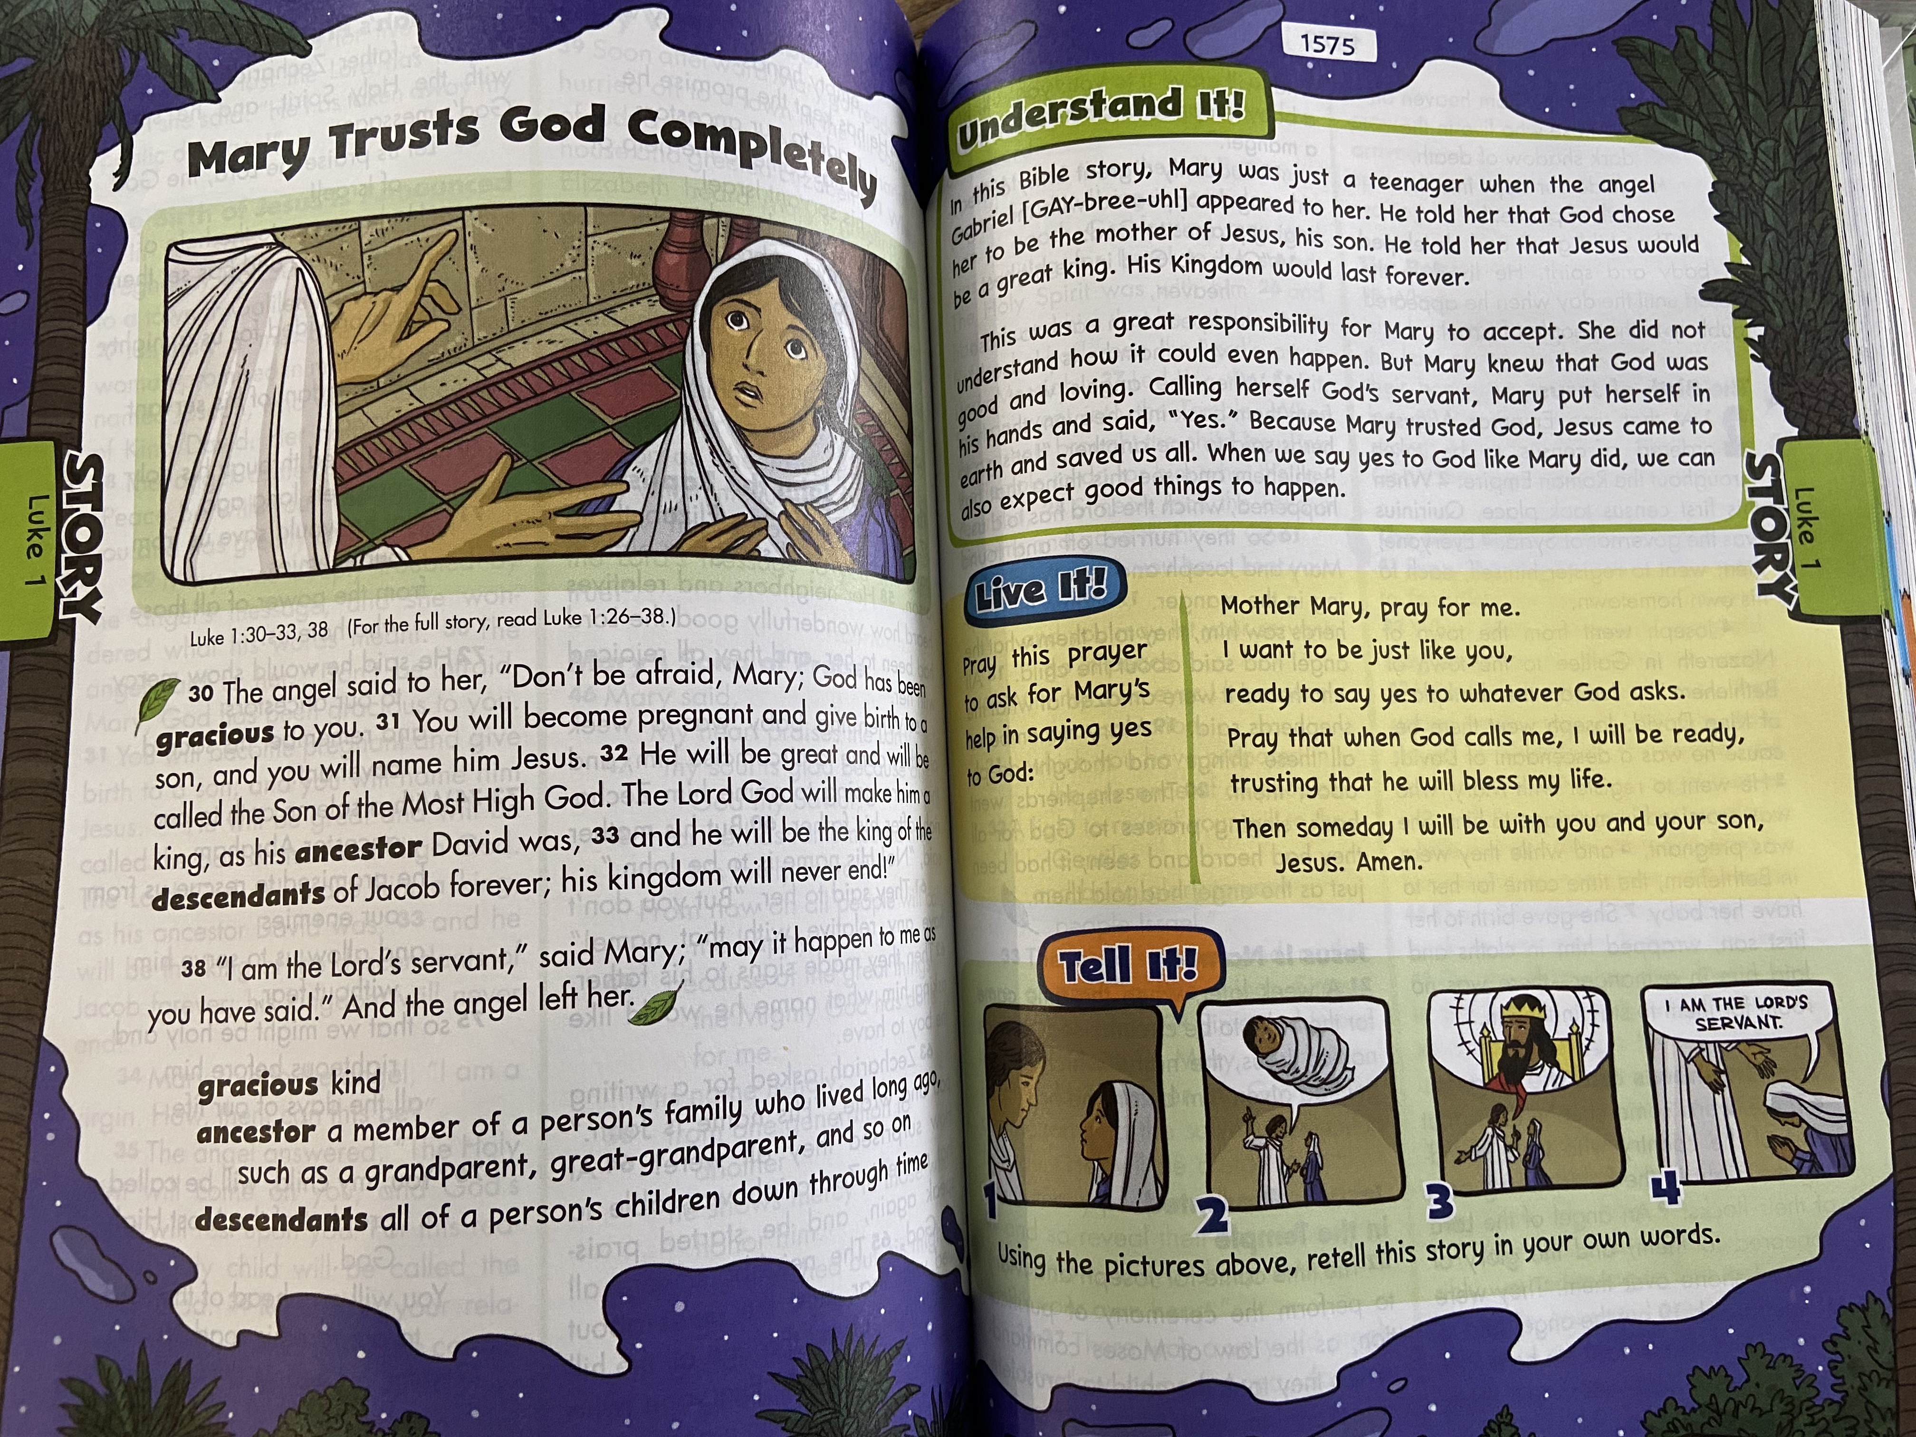
Mary’s Call

Slide 5
Jesus Calls the Disciples

Slide 6
Choosing a Confirmation Name

Slide 7
Activities to do at Home

