Slide 1
Welcome to Week Four
Come Holy Spirit, fill the hearts of your faithful and kindle in them the fire of your love

Slide 2
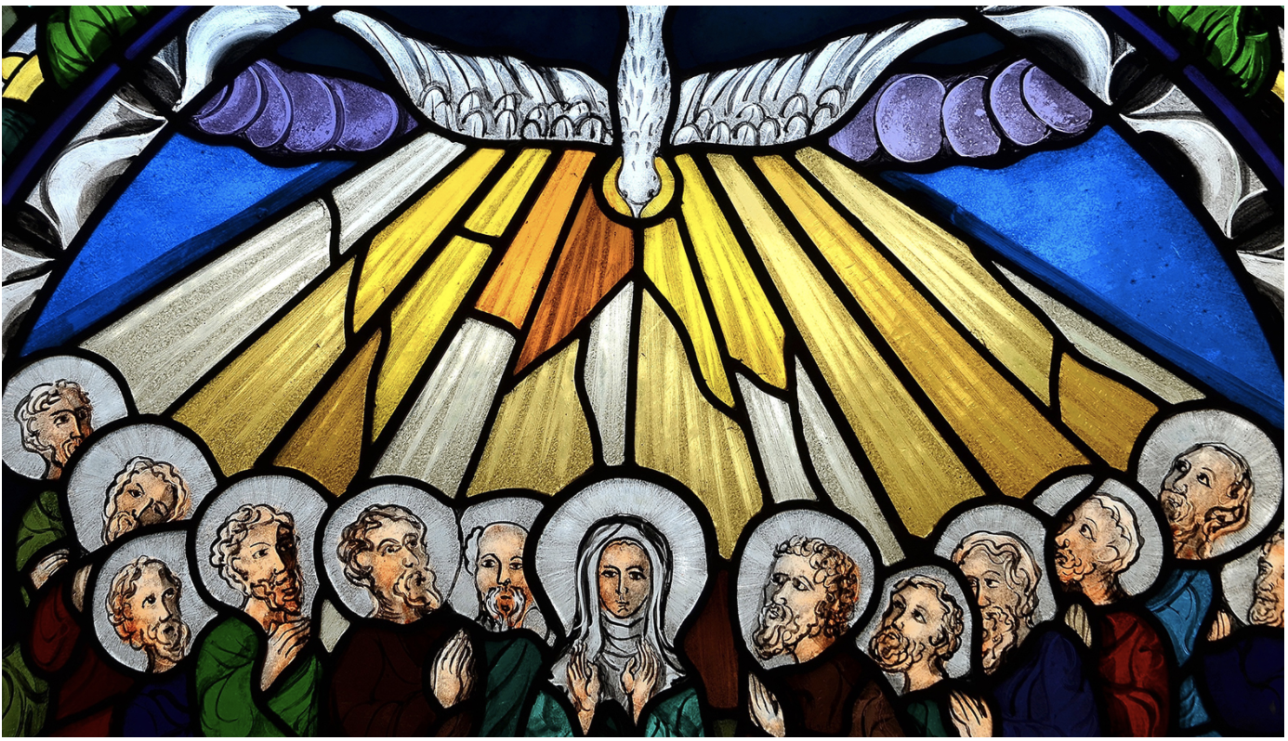
Pentecost

Slide 3
Pentecost

Slide 4
The Sacrament of Confirmation
The Sacrament of Confirmation consists of the renewal of baptismal promises and the laying on of hands and anointing with the oil of Chrism. The anointing of the candidate is a sign of confirming the gift of the Spirit, and calling the candidates to use these gifts to become involved in the life and mission of the community.
We are reminded of our participation in the ministry and mission of Jesus, and strengthened to follow Jesus more closely.

Slide 6
Sacred Symbols

Slide 7
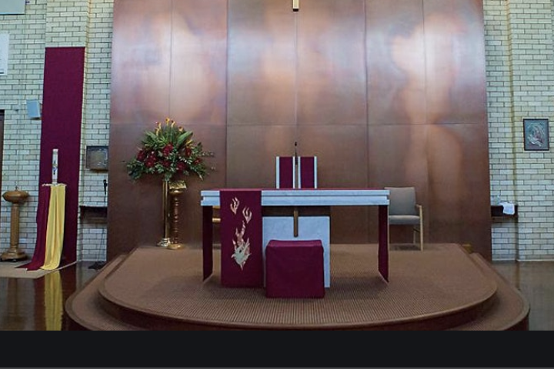
The Rite of Confirmation

Slide 8
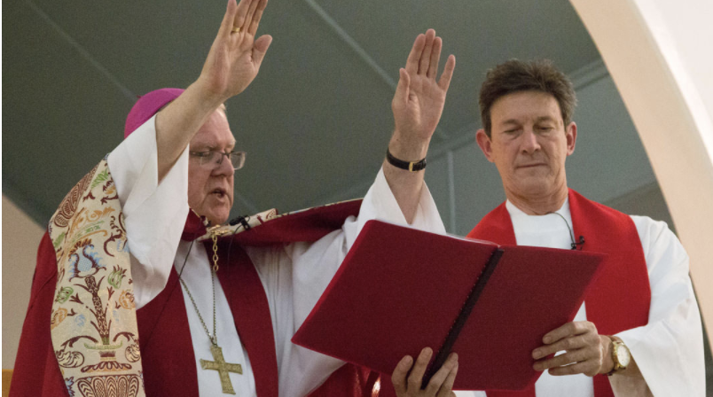
The Rite of Confirmation
The Laying on of Hands
The bishop places his hands on the head of the candidates and prays for the gifts of the Holy Spirit.
This ritualises the connection to Baptism and the strengthening of the Holy Spirit in our vocation to follow the way of Jesus.

Slide 9
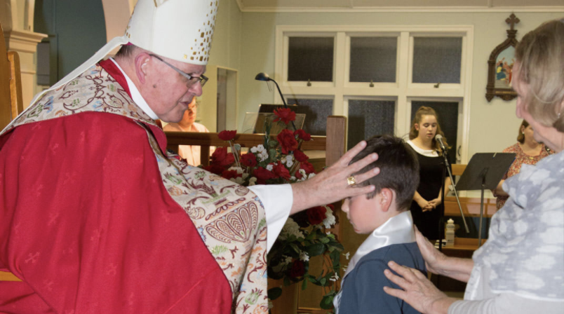
The Rite of Confirmation
Anointing with Oil
The anointing of the candidate at Confirmation recognises that they are sealed with the Holy Spirit.
The bishop anoints the candidate’s forehead with the Oil of Chrism, saying ‘Be sealed with the gift of the Holy Spirit’.

Slide 10
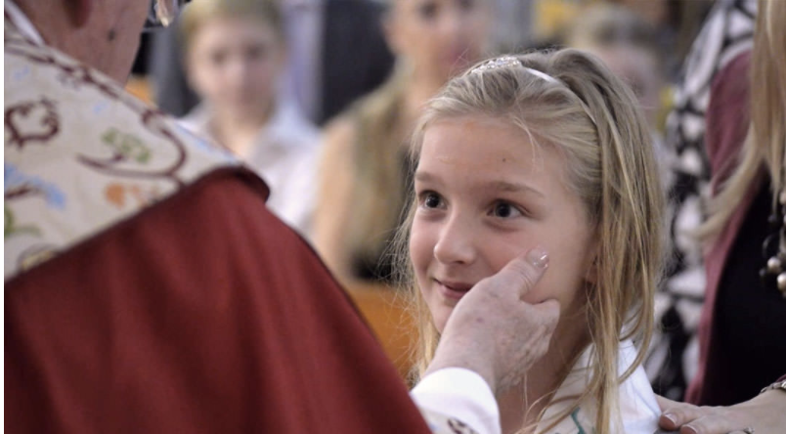
Rite of Confirmation
The Sign of Peace
At the end of the rite, the bishop puts his hand on the side of the candidate’s face and says ‘Peace be with you’ and the candidate replies with ‘And with your spirit’, symbolising the candidate’s place within the Church community.

Slide 11
Activities to do at Home

